Slide 1


Slide 2


TODAY’S AGENDA
Introduction To Jquery Selectors
Types Of Selectors
Syntaxes And Uses
Examples

Slide 3
INTRODUCTION TO SELECTORS
A very common task in jQuery is to read and modify the content of the page and to do this, we need to find the element(s) that we wish to change.
This is where selector support in jQuery will help us out.

Slide 4
INTRODUCTION TO SELECTORS
A selector in jQuery is a way to find elements of our page.
Selectors can select elements based on their ID, classes, types, attributes, values of attributes and much more.

Slide 5
GENERAL SYNTAX
Since selectors are the most common part of jQuery they come in several forms.
A selector takes a query as an argument , locates the element and returns a jQuery object.

Slide 6
GENERAL SYNTAX
Therefore, selecting a set of elements is as simple as this: $(<query here>)
With the jQuery object returned, we can then start using and altering the element.

Slide 7
THE id SELECTOR
A very common selector type is the ID based.
It uses the ID attribute of a HTML element to locate the desired element.
Syntax:
$(“#idvalue”)
Example:
$(“#div1”)

Slide 8
EXAMPLE
Jquery Code:
<script>
$(document).ready(function()
{
$("#p1").css("font-weight","bold");
});
</script>
HTML Code:
<p id="p1">
This is a para altered with jQuery.
</p>

Slide 9
THE class SELECTOR
Elements with a specific class can be matched by writing a . character followed by the name of the class.
Syntax:
$(“.classvalue”)
Example:
$(“.highlight”)

Slide 10
EXAMPLE
Jquery Code:
<script>
$(document).ready(function()
{
$(“.highlight").css(“color",“coral");
});
</script>
HTML Code:
<ul >
<li class="highlight">JavaScript</li>
<li>Java</li>
<li class="highlight">JQuery</li>
</ul>

Slide 11
THE element SELECTOR
Elements can also be selected on the basis of their tag names.
For example, all anchors can be selected as :
$(“a”)
Similarly all paragraphs can be selected as:
$(“p”)

Slide 12
THE element SELECTOR
We also can combine selectors as:
$(“li.highlight”)
This selects only listitems with class as “highlight”

Slide 13
THE attribute SELECTOR
Till now we have selected elements from their class or their ID attributes.
But with jQuery, we can actually find elements based on any kind of attribute.

Slide 14
THE attribute SELECTOR
The syntax for this selector is a set of square brackets with the name of the desired attribute inside it.
Syntax:
$(“element[attribute=value]”)

Slide 15
EXAMPLES
Find the anchor tag whose href is equal to http://www.youtube.com
$("a[href='http://www.youtube.com']").css("font-size","30px");
Find the input elements whose name attribute starts with ‘txt’:
$("input[name^='txt']").css("color", "blue");

Slide 16
EXAMPLES
Find the input elements whose name attribute ends with ‘txt’:
$("input[name$='txt']").css("color", "red");
Find the input elements whose name attribute contains a ‘txt’ :
$("input[name*='txt']").css("color", "blue");

Slide 17
PARENT CHILD SELECTORS
jQuery also allows us to select elements based on their parent elements.
There are two variations:
One , which will only match elements which are a direct child to the parent.
Another , which will match all the way down through the hierarchy, eg. A child of a child of an element.

Slide 18
SYNTAX FOR DIRECT CHILD
The syntax for finding children which are direct descendants of an element :
$(“div>a”);
This selector will find all links which are direct child of a div element.

Slide 19
SYNTAX FOR ANY CHILD
Replacing the greater-than symbol with a simple space will change this to match all links within a div elements, no matter if they are directly related or not:
$(“div a”);

Slide 20
EXAMPLE (Direct Child)
<html>
<head>
<title>Direct Child Selector</title>
<script src="../jquery.js"></script>
<script>
$(document).ready(function () {
$("#div1>ul").css("color", "blue");
});
</script>
</head>

Slide 21
EXAMPLE(Direct Child)
<body>
<div id="div1">
<ul>
<li>C++</li>
<li>Java</li>
</ul>
<div>
<ul>
<li>.Net</li>
<li>PHP</li>
</ul>
</div>
</div>
</body>
</html>

Slide 22
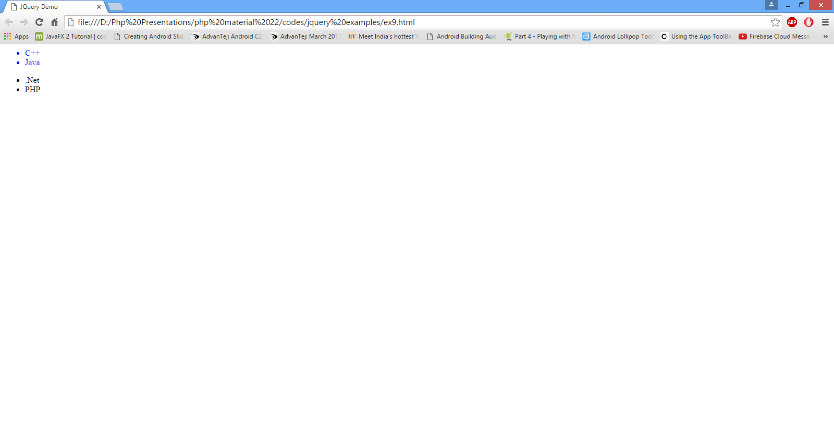
OUTPUT(Direct Child)

Slide 23
EXAMPLE(Any Child)
<html>
<head>
<title>Indirect Child Selector</title>
<script src="jquery.js"></script>
<script>
$(document).ready(function () {
$("#div1 ul").css("color", "blue");
});
</script>
</head>

Slide 24
EXAMPLE(Any Child)
<body>
<div id="div1">
<ul>
<li>C++</li>
<li>Java</li>
</ul>
<div>
<ul>
<li>.Net</li>
<li>PHP</li>
</ul>
</div>
</div>
</body>
</html>

Slide 25
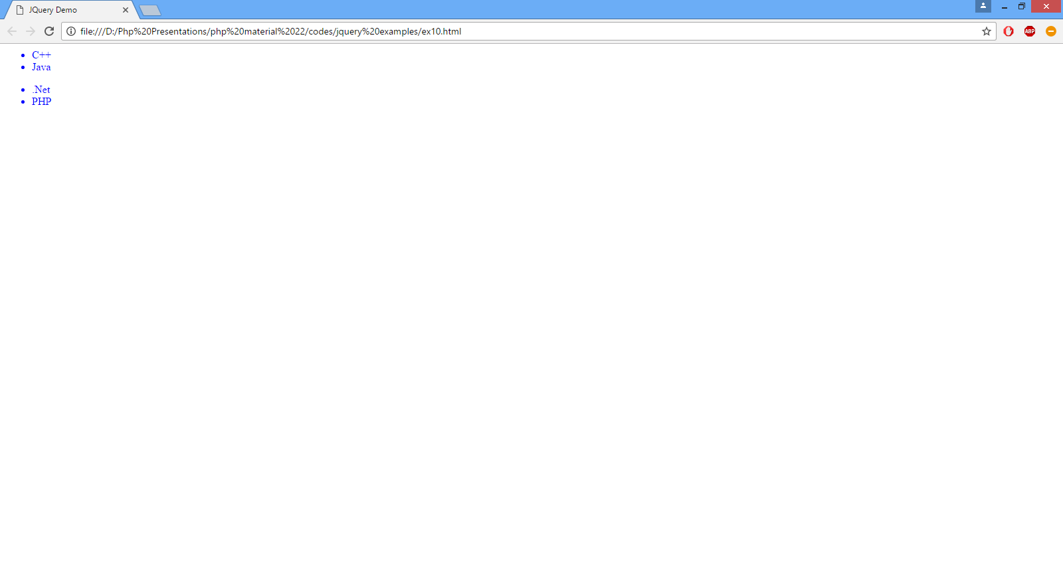
OUTPUT(Any Child)

